Slide 1

HEMOPHAGOCYTIC LYMPHOHISTIOCYTOSIS IN HIV INFECTION
PRESENTER :
MOHAMMED HUSSAIN DEPT. OF GENERAL MEDICINE YENEPOYA UNIVERSITY

Slide 2

INTRODUCTION TO HLH
Hemophagocytic lymphohistiocytosis (HLH) is a syndrome of unregulated macrophage activation resulting in overproduction of inflammatory cytokines and Hemophagocytosis.
It is classified as one of the cytokine storm syndromes.
Secondary HLH is due to another underlying disease process such as infection, autoimmune disease, or malignancy.

Slide 3
PATIENTS HISTORY
A 35-Year old male, Coolie worker presented to our hospital (Yenepoya Medical College) with complaints of –
Intermittent fever with chills – 8 Month
Night-sweats since - 8 Month.
Constitutional symptoms like – weight loss, appetite loss and generalised weakness were also present.
He reported a swelling over neck and productive cough since 2-Month.

Slide 4
HISTORY OF PRESENTING ILLNESS
Patient was apparently alright prior to 8 Month, he developed Fever, intermittent type (once in 7-8 days). Associated with chills and sweat, Aggrevated at Night. Relieved on medication and again recurred after 2 Days.
There was h/o weight loss (not quantified). Patients brothers told that the patient had lost 40% of his weight.
H/o appetite loss x 3M.Also gives h/o fatigue.
H/o cough with sputum x 1M,mucoid,not bloodtinged.
No h/o Pain abdomen, vomiting, TB contact.

Slide 5
EXAMINATION FINDINGS
Patient on examination was concious, co-operative and well oriented
Patient was Emaciated,Febrile
Pulse Rate -140 bpm
Blood Pressure -100/70 mm Hg
Temperature - 101⁰ F
Respiratory Rate -22/min
SpO2 (Oxygen Saturation)- 99% at RA
There was also presence of Pallor and Icterus.

Slide 6
Physical examination revealed wasted individual with Oral-Candidiasis and Generalised Lymphadenopathy (bilateral cervical and axillary) which were discrete, rubbery and not matted.
Cardiovascular System – Normal S1 S2. No murmur.
Per-Abdomen : Hepatosplenomegaly present.
Respiratory System : Inspiratory crackles were heard in Right Infra-Axillary area.
He was started on Antibiotics, Antifungal and other supportive measures. Despite this his BP continued to reveal on lower side.

Slide 7
Patient continued to run-fever making the possibility of Adrenal-Tuberculosis were likely.
Patient had Hypokalemia, Hyponatremia which was corrected by replacement and reptans, SIADH (Syndrome of Inappropriate ADH-secretion).
Persistent anaemia was present over coarse of first 5-10Days.
His platelet count progressively worsened, as well as developed significant Leucopoenia (900cells/mm3). In this period his Renal Function showed mild elevation.

Slide 8
INVESTIGATIONS
Hb | 8.2
TC | 1.3
DC | N-74,L-19 M-16,E-1
ESR | 8
BU | 29
Creatinine | 1.0
Na⁺ | 121
K⁺ | 3.5
TB | 1.7
DB | 1.4
IB | 0.3
SGOT | 392
SGPT | 144
SAP | 343
TP | 5.2
ALB | 2.2
S.CREATININE | >1000
TRIGLYCERIDE | 256
PERIPHERAL SMEAR:
PANCYTOPENIA – MICROCYTIC HYPOCHROMIC
LEUCOCYTOPENIA
THROMBOCYTOPENIA

Slide 9
Patient’s HIV Status came POSITIVE
CD4-Count was requested. (CD4 - 44)
Lymphnode Biopsy – Tuberculous lymphadenitis
Patient had Hypertriglyceridemia and Normal Iron-profile.
Based on above finding we could fit the patients condition within the 2008-Guidelines for HEMOPHAGOCYTIC LYMPHO HISTOCYTOSIS-HLH (2008 Guidelines for American Rheumatoid Association)
Bone-marrow aspirational biopsy was requested which revealed - HEMOPHAGOCYTOSIS. (ie., s/o Pancytopenia caused by incraesed destruction of cells. Foamy histiocytes exhibiting phagocytosis of blood cells noted)

Slide 10
Current (2008) diagnostic criteria for HLH
A molecular diagnosis consistent with HLH. These include identification of pathologic mutations of PRF1, UNC13D, or STX11.
(OR)
Fulfillment of 5 out of the 8 criteria below:
Fever (>100.4 °F, >38 °C)
Splenomegaly
Cytopenias affecting at least 2 of 3 lineages in PB :
Haemoglobin <9 g/100 ml (in infants <4 weeks Hb<10 g/100 ml)
Platelets <100×10³/dL
Neutrophils <1000/dL

Slide 11
4. Hypertriglyceridemia (fasting > or equal to 256 mg/100 ml) and/or Hyprofribrinogenemia (≤ 150 mg/100 ml).
5. Ferritin ≥ 500 ng/ml.
6. Haemophagocytosis in the Bone marrow, Spleen or Lymph nodes.
7. Low or absent Natural Killer (NK cell) activity.
8. Soluble CD25 (soluble IL-2 receptor) >2400 U/ml.

Slide 12
In this CASE :
Persistant fever of > 100.3F
USG – Splenomegaly (Present)
Cytopenia affecting all
3 cell lineages
4. Ferritin ->1000
Triglyceride – 256
Bone marrow showed Haemophagocytosis.
Hb | 8.2
TC | 1.3
DC | N-74, L-19 M-16,E-1
PLT | 74000
FERRITIN | >1000
TRIGLYCERIDE | 256

Slide 13
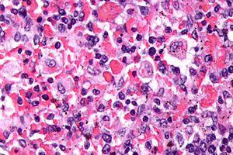
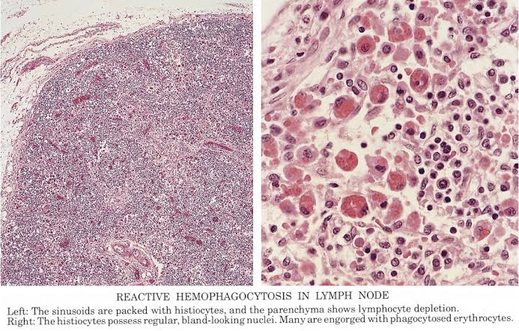
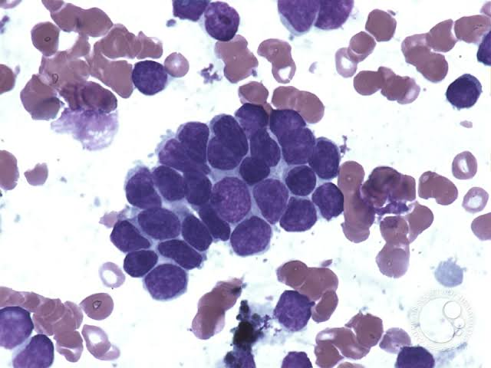
DIFFERENT PRESENTATION OF HLH
HEMOPAGOCYTIC LYMPHOHISTIOCYTOSIS IN HIV
REACTIVE LYMPHOCYTOSIS IN LYMPHNODE
HLH IN BONE MARROW ASPIRATED BIOPST

Slide 14
TREATMENT
The patient was started on Anti-Tuberculosis treatment along with steroids.
Over period of next 2-Month patient showed gradual improvement and was discharged.
On modified ATT(Anti-Tubercular Treatment)(on account of drug-induced Hepatitis) and ART(Anti-Retrovial Therapy : Tenofovir, Lamivudine, Efavirenz)
On regular follow-up patient is doing well, WBC(White Cell Count) are normal, no anemia. The patient has gained weight, has got no fever

Slide 15
WHY IS THIS CASE INTERESTING?
HLH as an entity is rare and secondary HLH due to HIV infection is even more rare.
HLH not a usual presentation in HIV infection
Early detection and prompt treatment can be life saving.
HIV infection can present with secondary HLH

Slide 16

THANKYOU!

